Slide 1


Egyptian Space Agency
Egyptian Universities Training Satellite Project
EUTS
Anomaly Detection for Satellite Telemetry Data Using Machine Learning
Prepared by
Helwan University
Computer and Artificial intelligence–Computer Science T42

Slide 2
Introduction
Project Idea: detect of telemetry data that come from satellites with using of machine learning algorithms,
Telemetry data is set of measurement and reading of embedded device Across time interval
In this project ,we use two dataset consist of Date and Temperature records ,after preprocessing dataset we use time series and machine learning algorithm to detect future temp

Slide 3
Data Analysis

Slide 4

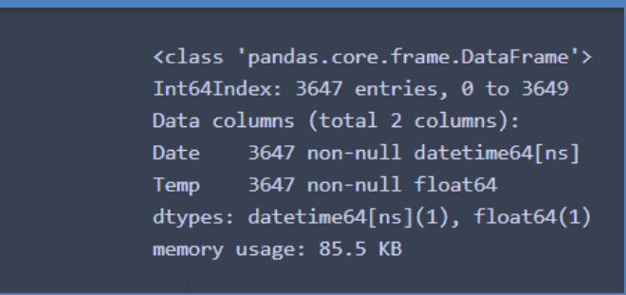
Dataset 1
First we load dataset 1 and 2 and try to figure them out, by see column , datatypes…etc.
dataset 1 consists of one column "Date","Temp" and we try to separate them into two columns ‘Date’ , ‘temp’
Convert temp column data type from string to float
Convert Date column data type from string to Datetime
Drop Null values and check for Duplicated
Finally data after Cleaned

Slide 5
Dataset 1
First we load dataset 1 and 2 and try to figure them out, by see column , datatypes…etc.
dataset 1 consists of one column "Date","Temp" and we try to separate them into two columns ‘Date’ , ‘temp’
Convert temp column data type from string to float
Convert Date column data type from string to Datetime

Slide 6
Dataset 2
First we load dataset 2 and try to figure them out, by see column , datatypes…etc.
dataset 2 it consists of one column "Month","Sunspots" "Date","Temp" we try to seprate this column into two column Date and Sunspots
convert data type for Sunspots from String to float
Convert Date column data type from string to Datetime
we found two issue at index 7 where year and month are swapped ,at index 489 invalid month
Drop Null values and check for Duplicated

Slide 7
ARIMA Model

Slide 8

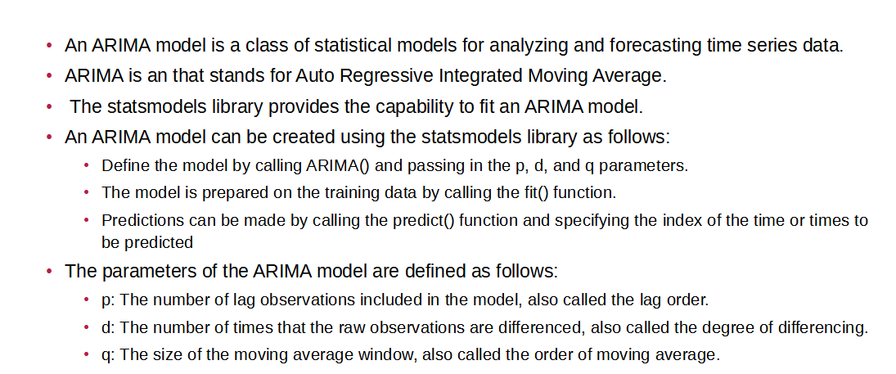

Slide 9
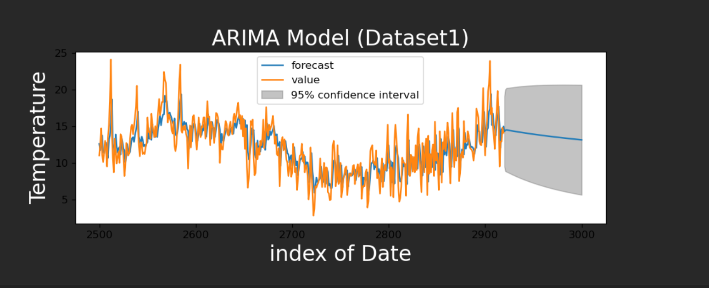
Result “Mean Square Error:4.01

Slide 10
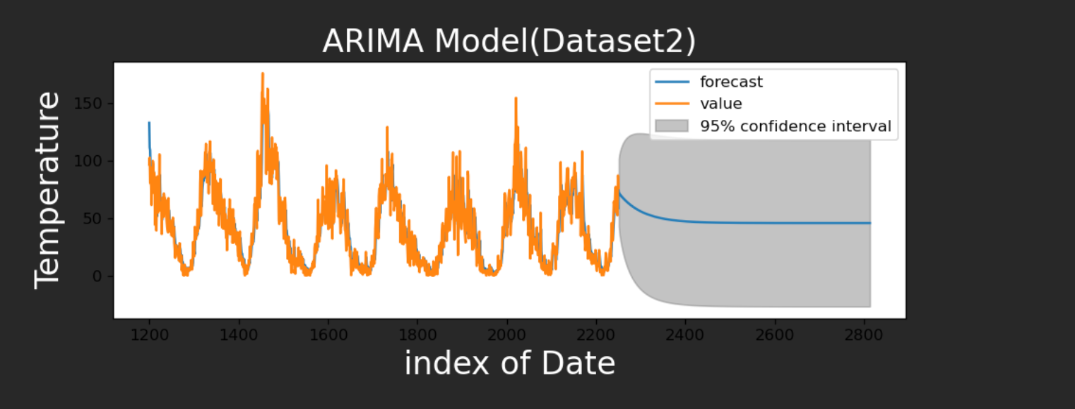

Slide 11
ARMA Model

Slide 12

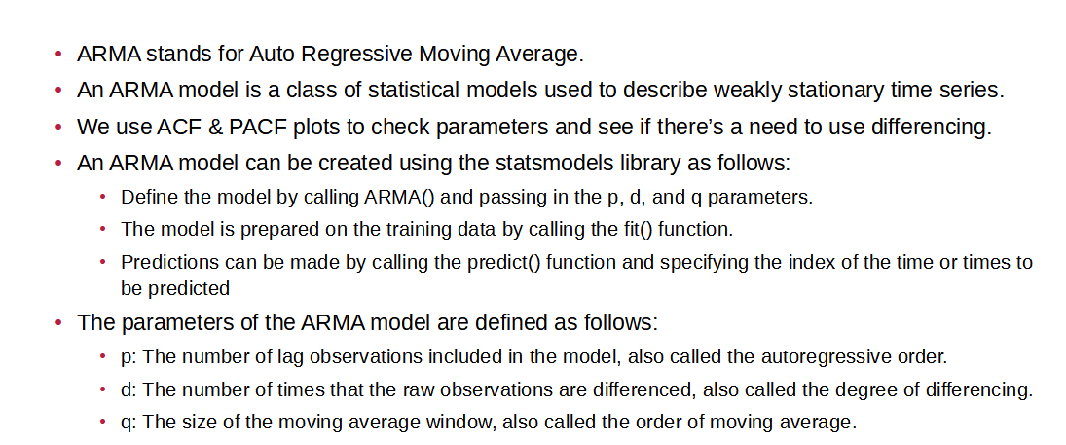

Slide 13
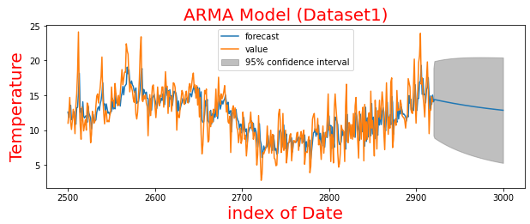
Result “Mean Square Error:3.987

Slide 14
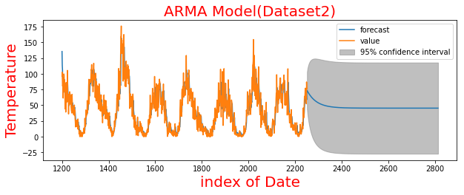
Result “Mean Square Error:62.247

Slide 15
SES Model

Slide 16
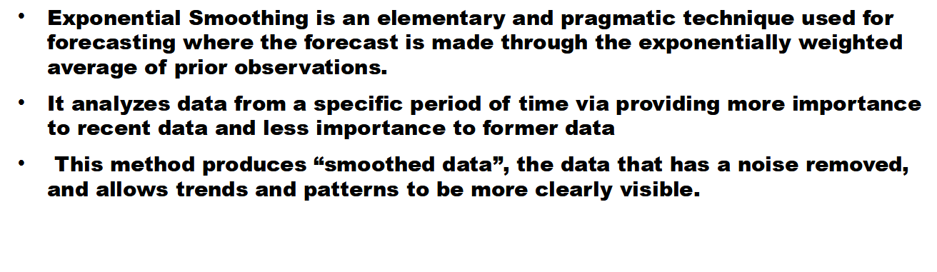
INTRODUCTION TO SES

Slide 17
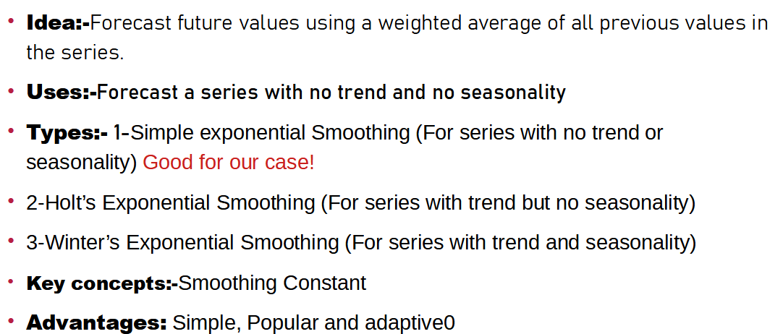

Slide 18
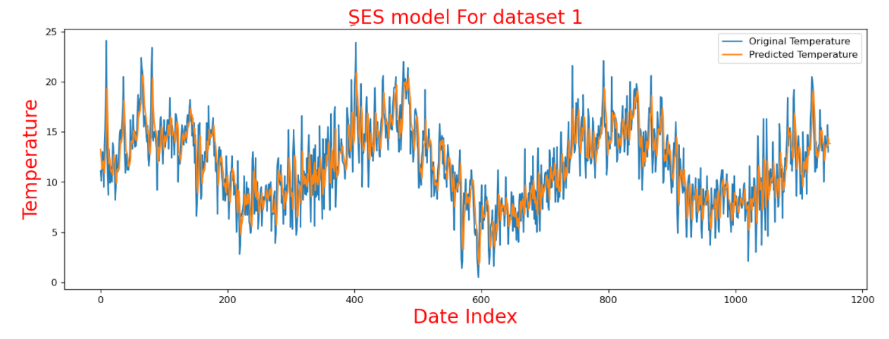


Slide 19
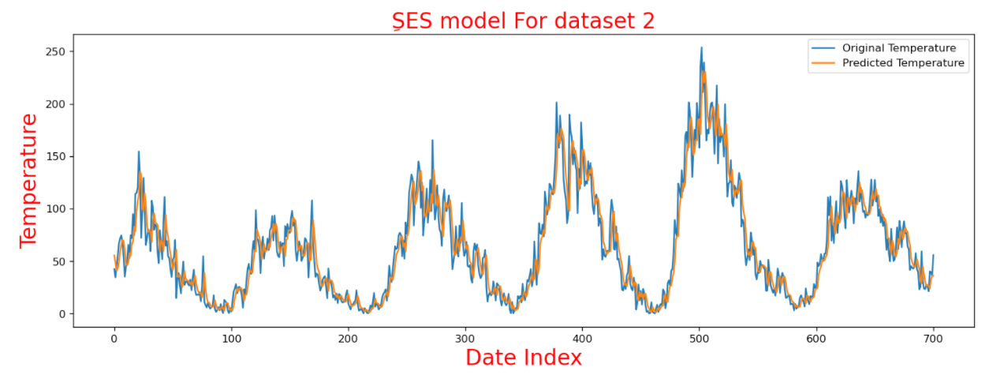


Slide 20
LSTM Model

Slide 21
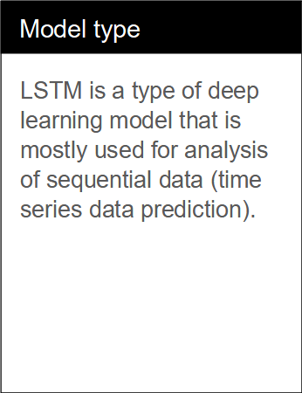
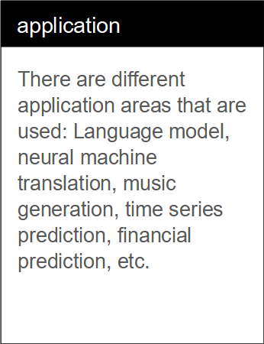
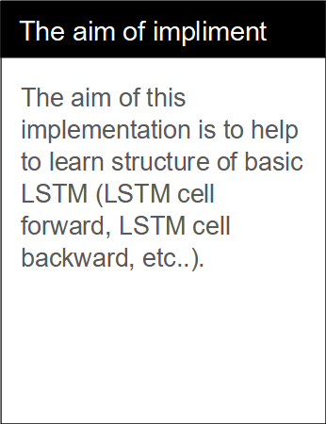

Slide 22


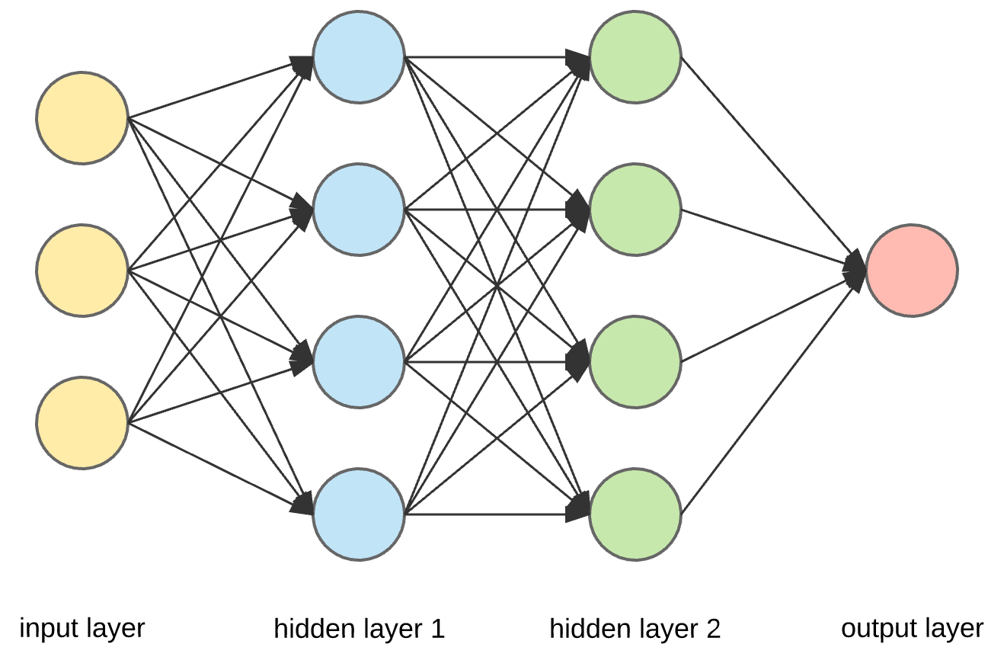
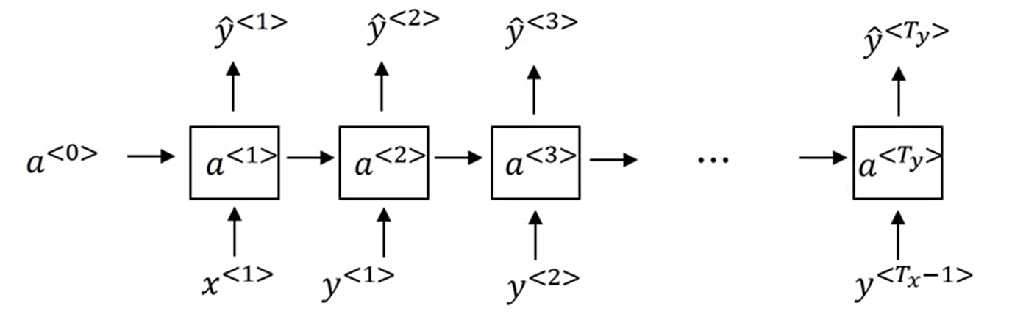

Slide 23
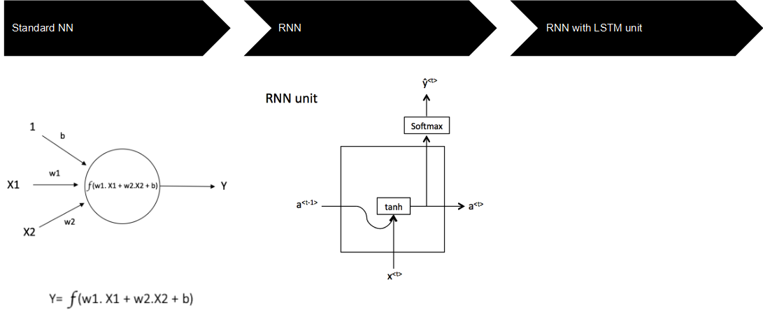
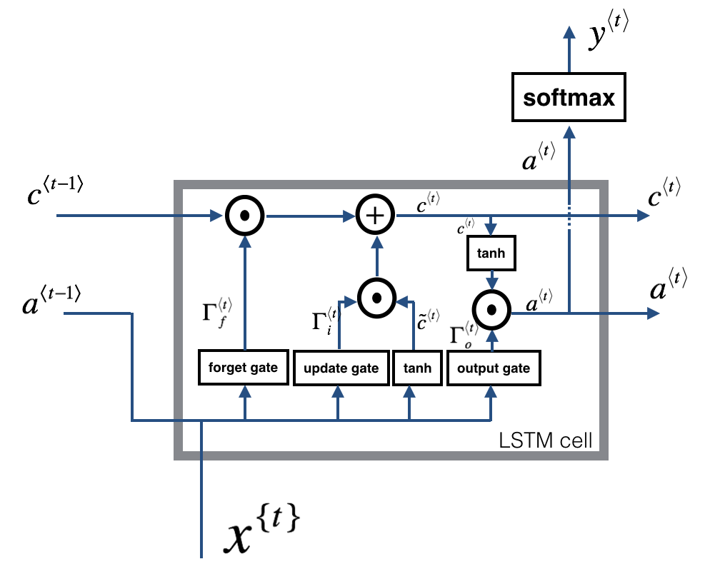

Slide 24
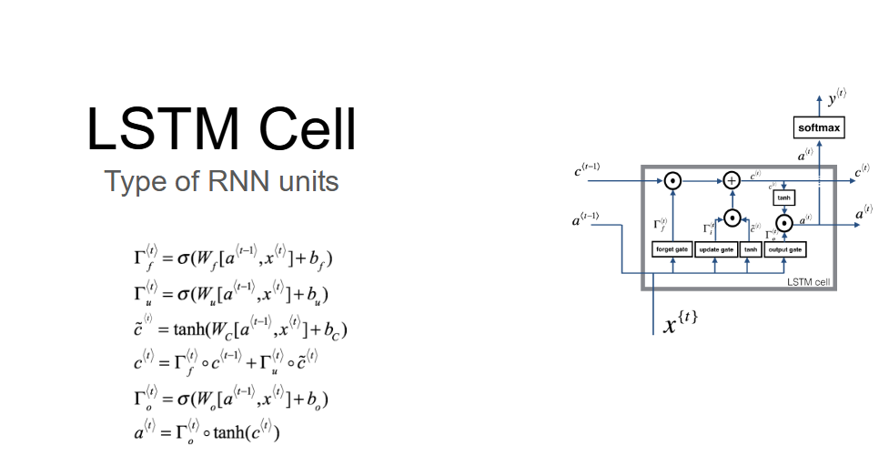

Slide 25
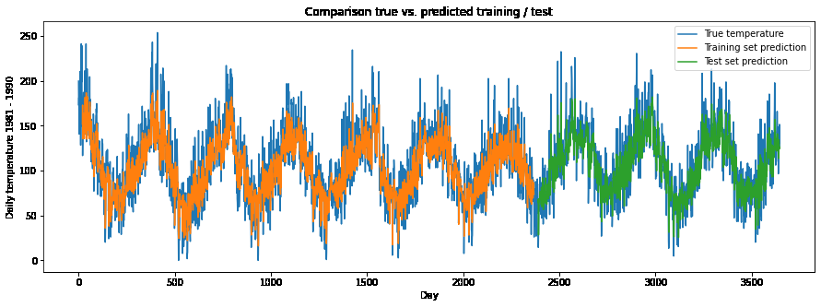

Slide 26
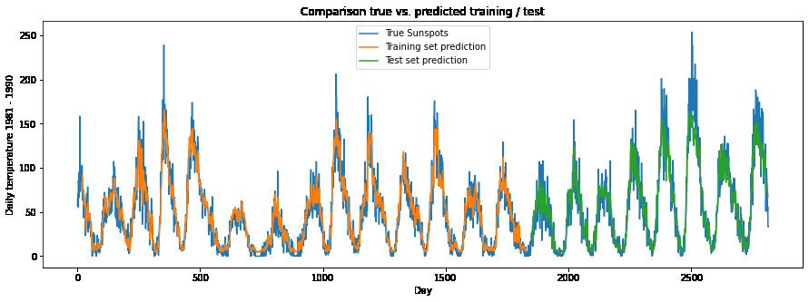

Slide 27
XGBOOST Model

Slide 28
Description
XGBoost is an efficient implementation of gradient boosting for classification and regression problems.
XGBoost can also be used for time series forecasting, although it requires that the time series dataset be transformed into a supervised learning problem first.

Slide 29
implemented in project
-First thig we Give Index Instead of Data to use XGBoost
-then, we split data to train and test with size 0.8 to train and without random state
- we try to find the best n_estimator through mean square error calculation then we select Best n_estimator for Dataset 1 is 100 and Dataset 2 is 70
-after that we predict our data and here is the prediction result on plot:

Slide 30
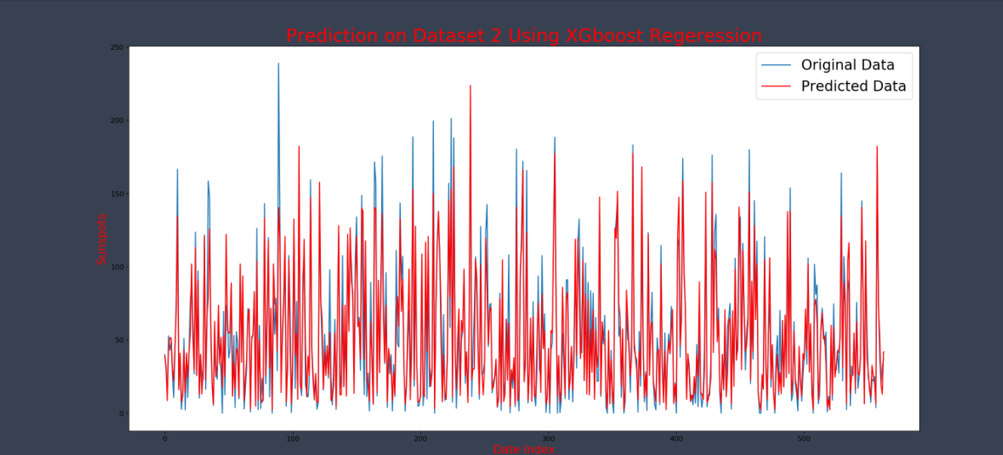
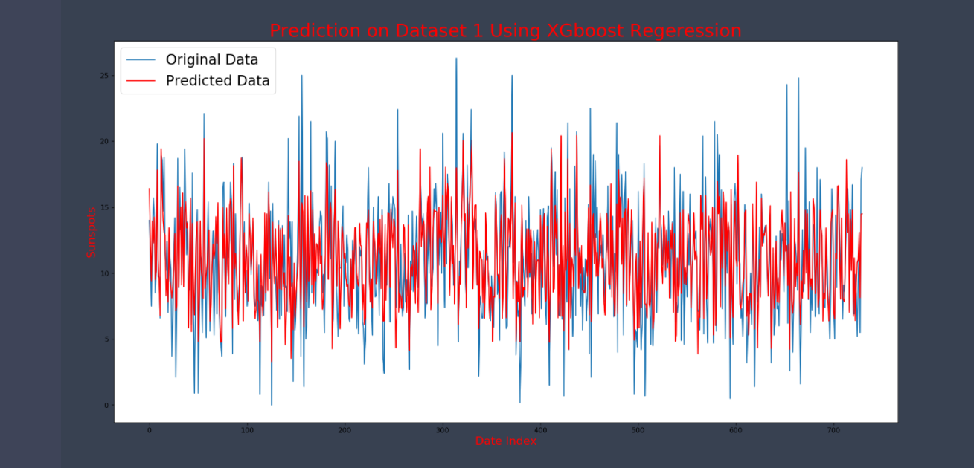

Slide 31
GRU Model

Slide 32
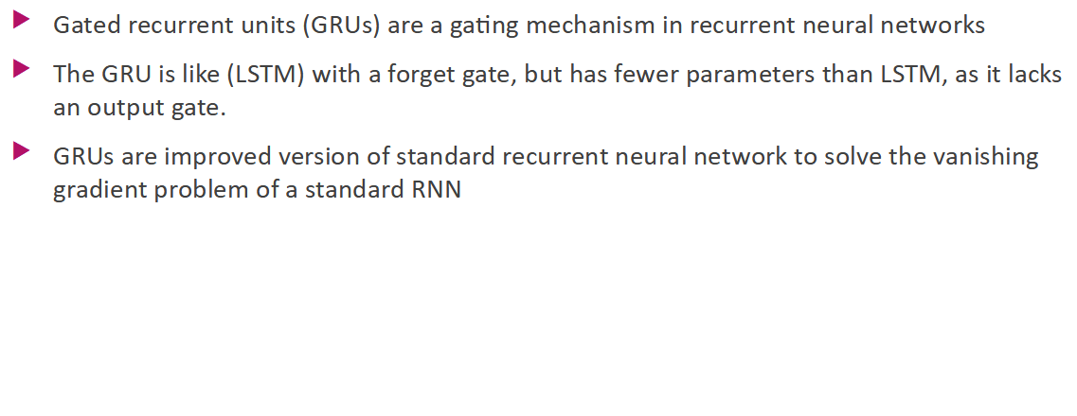

Slide 33
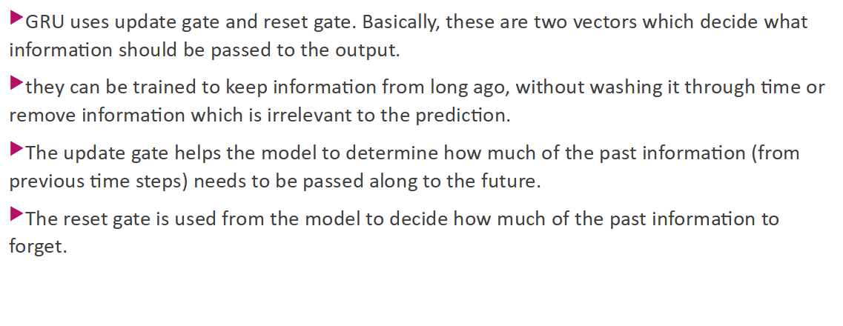

Slide 34
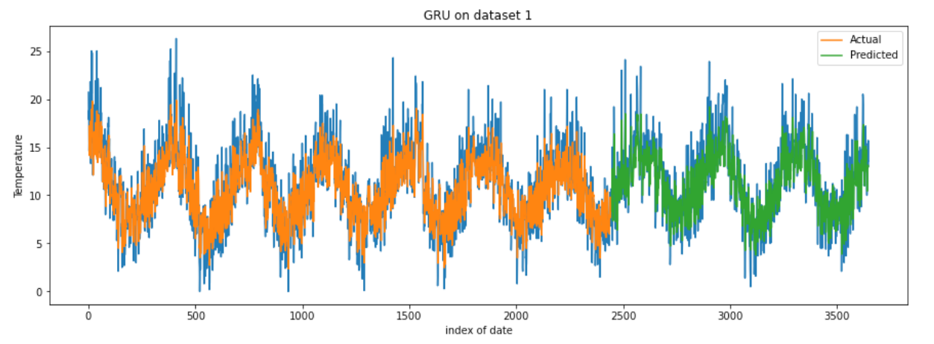

Slide 35
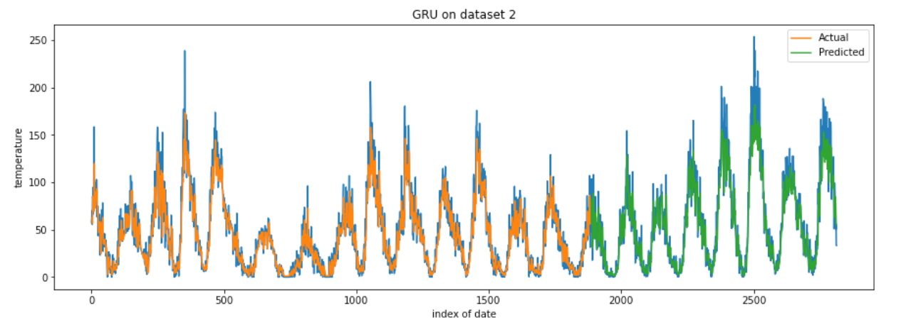

Slide 36
